Slide 1
Customer retention
A case study

Slide 2
Introduction
Customer satisfaction has emerged as one of the most important factors that guarantee the success of online store; it has been posited as a key stimulant of purchase, repurchase intentions and customer loyalty. A comprehensive review of the literature, theories and models have been carried out to propose the models for customer activation and customer retention. Five major factors that contributed to the success of an e-commerce store have been identified as: service quality, system quality, information quality, trust and net benefit. The research furthermore investigated the factors that influence the online customers repeat purchase intention. The combination of both utilitarian value and hedonistic values are needed to affect the repeat purchase intention (loyalty) positively. The data is collected from the Indian online shoppers. Results indicate the e-retail success factors, which are very much critical for customer satisfaction

Slide 3
Data
It has 71 columns with 269 rows
All values are of object type except “What is the pin code of where you shop from?”.

Slide 4
Univariate Analysis:

Slide 5
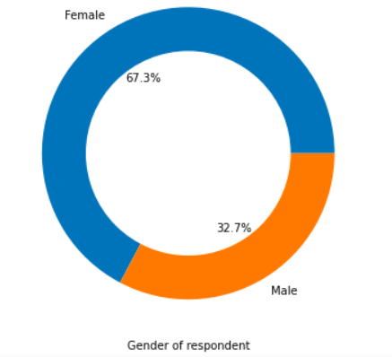
Gender of respondent
We have gender as:
67.3% females
32.7% Males

Slide 6
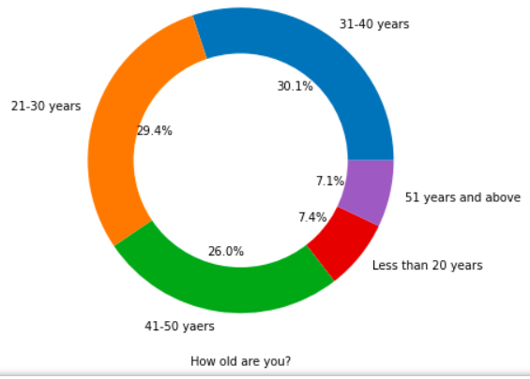
Age – How old are you?
We have people’s age as:
7.4% in range of 0-20 yrs
29.4% in range of 21-30 yrs
30.1% in range of 31-40 yrs
26.0% in range of 41-50 yrs
7.1% in range of 51 yrs and above

Slide 7
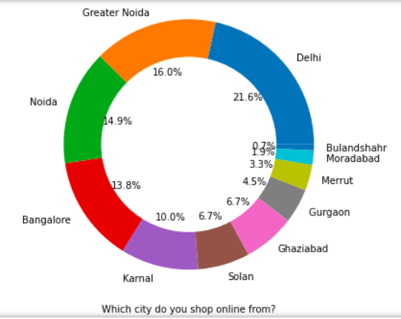
Which city do you shop online from?
We have people in cities as:
16.0% in Greater Noida
21.6% in Delhi
0.7% in Bulandshahr
1.9% in Moradabad
3.3% in Meerut
4.5% in Gurgaon
6.7% in Ghaziabad
6.7% in Solan
10.0% in Karnal
13.0% in Bangalore
14.9% in Noida

Slide 8
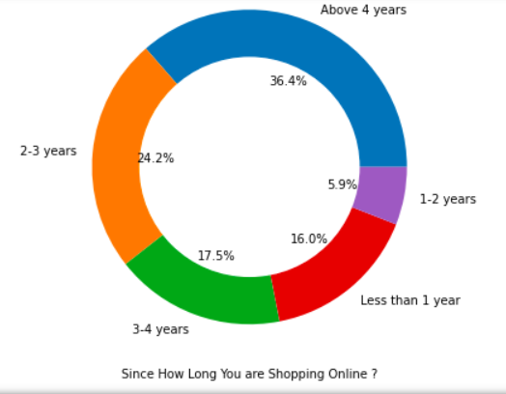
Since how long you are shopping online.
We have online shopping experience as:
16.0% of 1 yrs and less
5.9% of 1-2 yrs
24.2% of 2-3 yrs
17.5% of 3-4 yrs
36.4% of 4 yrs and above

Slide 9
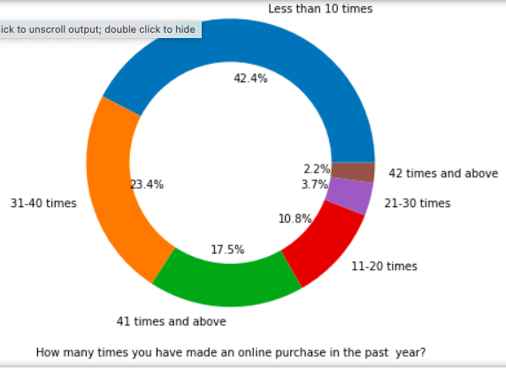
How many times you have made an online purchase in the past year?
No. of times shopped online in last year:
42.4% less than 10 times
10.8% 11-20 times
3.7% 21-30 times
23.4% 31-40 times
2.2% 42 times and above
17.5% 41 times and above

Slide 10
Conclusion:
There is double the number of women than men who have taken this survey. -Most of the people are in their 30's followed by 20's, teenagers and senior citizen are the least in number. -Most of the people belong from delhi, noida and banglore, ambiguity can also be seen as noida has two categories (noida and grater noida) which need to be handled -Most of the people shopping online have been shopping from a long time. -Majority of people shop online 10 times a year, amiguity can also be seen for range 42 times and above which needs to be handled.

Slide 11
Analysis on the basis of Various following factors

Slide 12
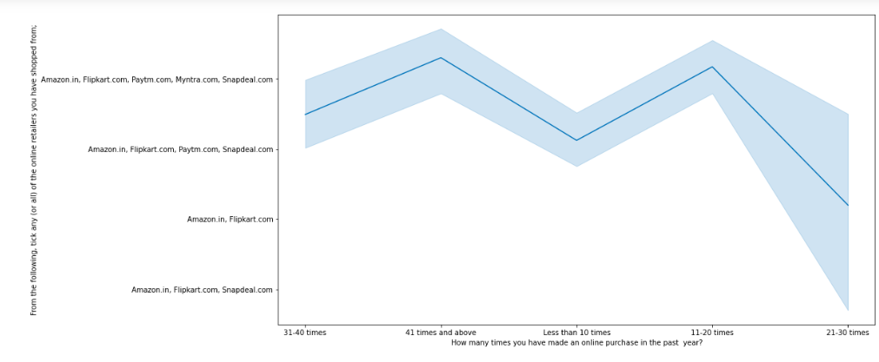
Conclusion: Heavy shoppers who shop more than 41 times a year shop from all the online brands, some of the people who shop for 32-40 and less than 10 times a year seem to exclude myntra. People shop from Amazon and flipkart whatever be the case.

Slide 13
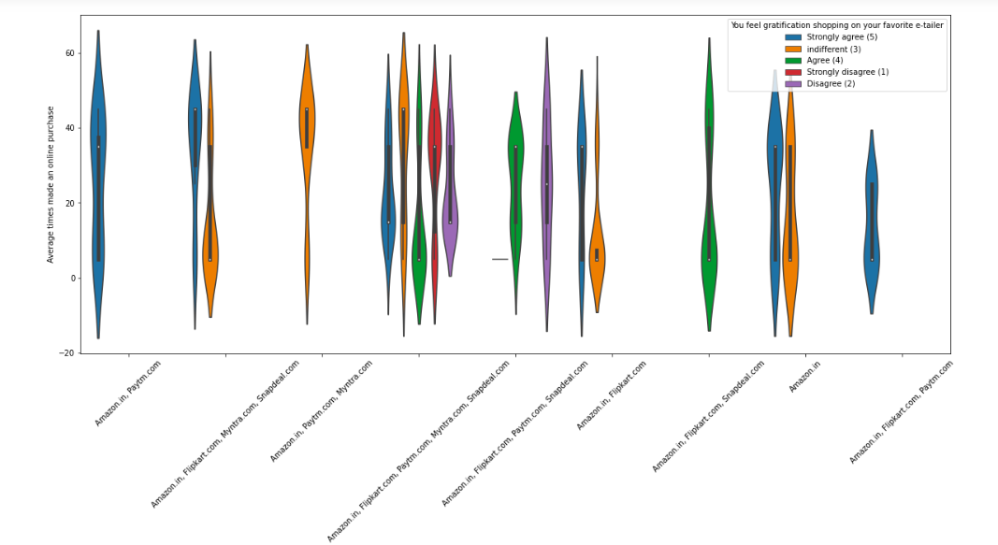
Conclusion: Almost all the people who have shopped from amazon, flipkart and paytm are satisfied. People who shop from a more number of online brands dosent seem to be satisfied.

Slide 14
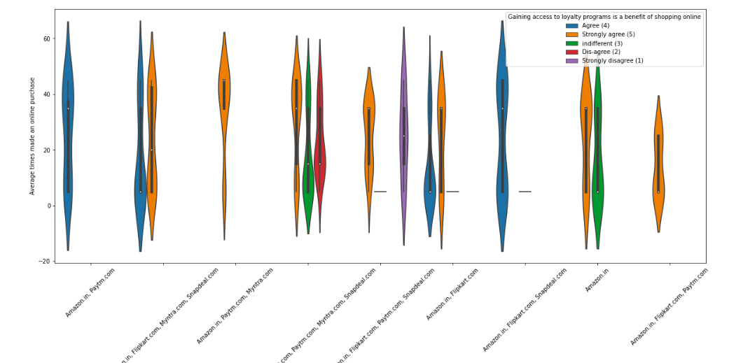
Conclusion: People shopping from amazon and paytm are getting benefits from the loyalty points, flipkart and sanpdeal also seem to give such benefits but people who shop from almost everywhere disagree with this statement too

Slide 15
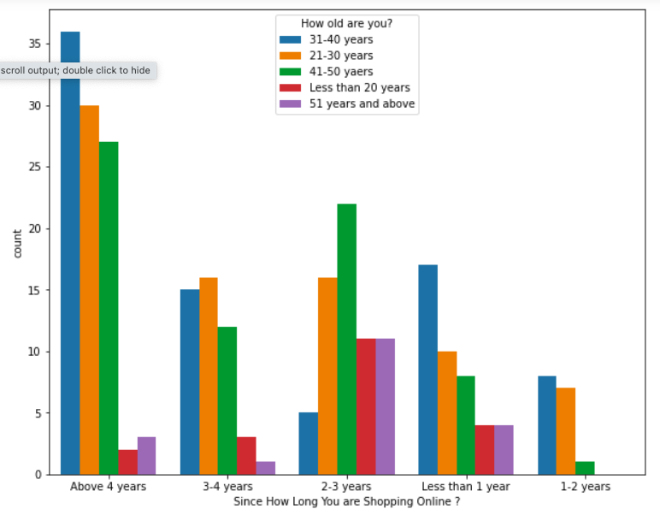
Conclusion: Highest number of people have been shopping online for above 4 years except for the age group below 20 years and above 50 years. People who are shopping online for 1-2 years does not include teenagers and elder people.

Slide 16
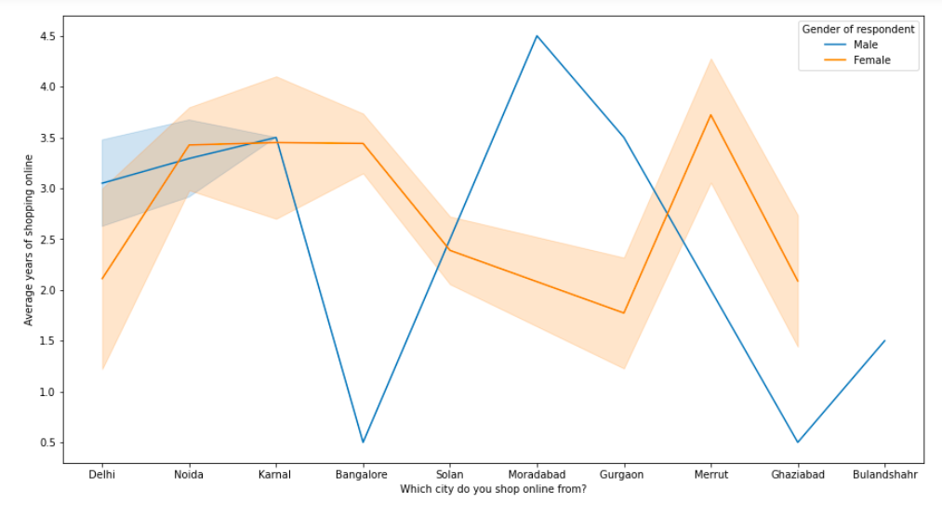
Conclusion: In lines, we can see that density of female customers is more than male. Men living in banglore and ghaziabad shop have shopped online for less than 1 year. Highest number of men shopping online belong from delhi and noida, while men from moradabad have been shopping online for the longest. Women from meerut and noida have shopped the longest.

Slide 17
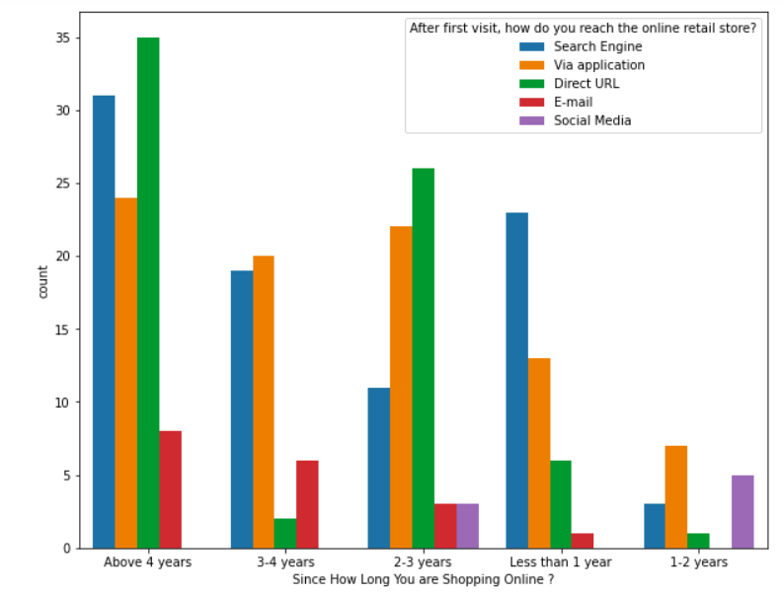
Conclusion: Even though people who are shopping online for more than 3 years donot use the application rather use search engine and direct url's in large number which indicates that online brands should update all their platforms rather than just application.

Slide 18
Brand image:

Slide 19
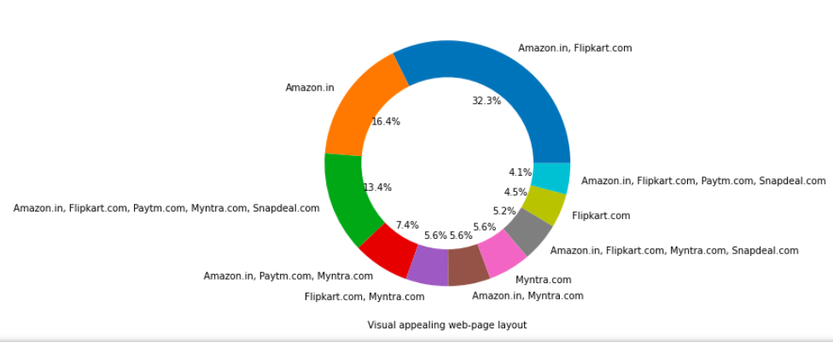
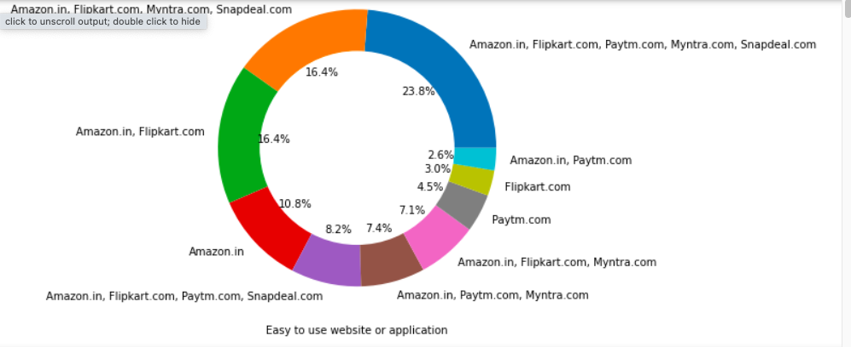
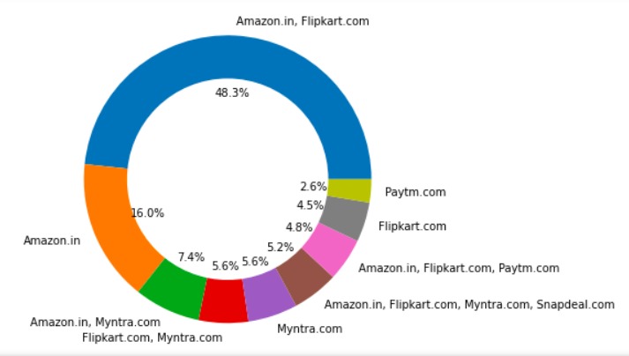
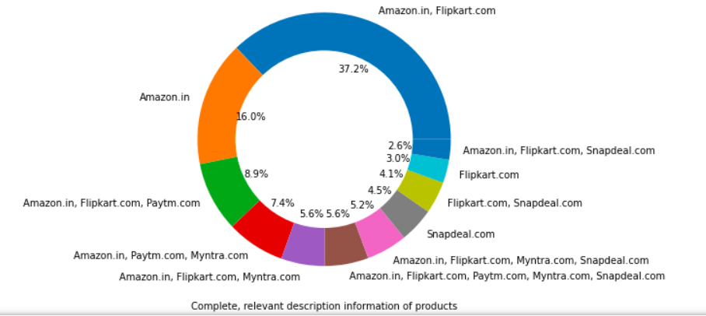

Slide 20
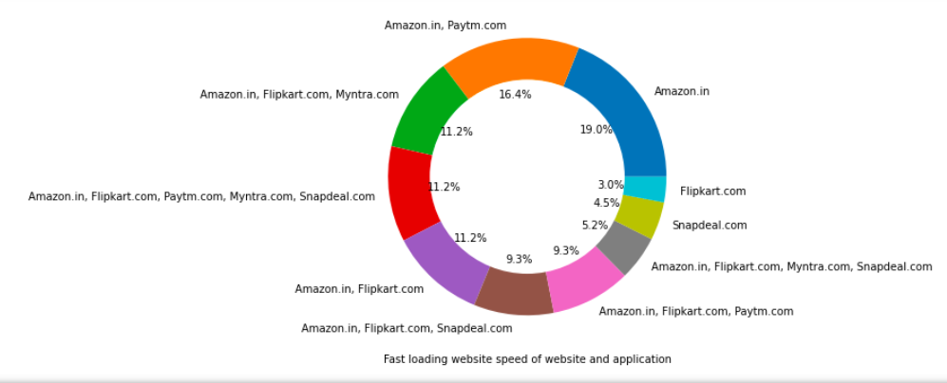
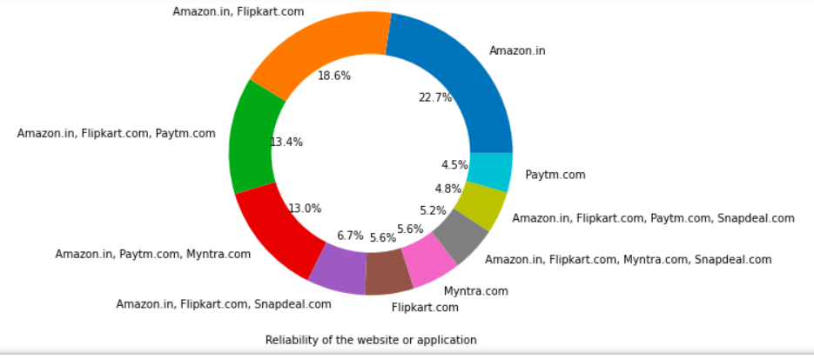
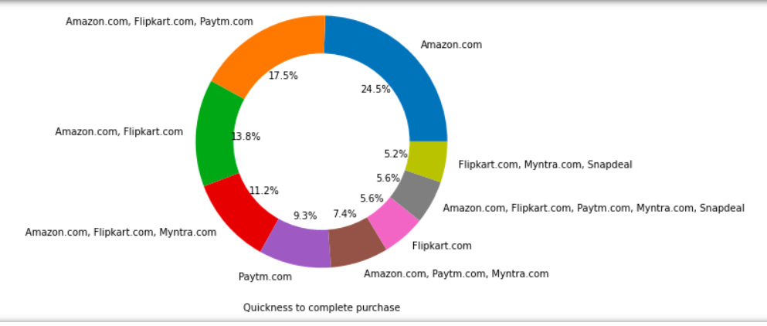
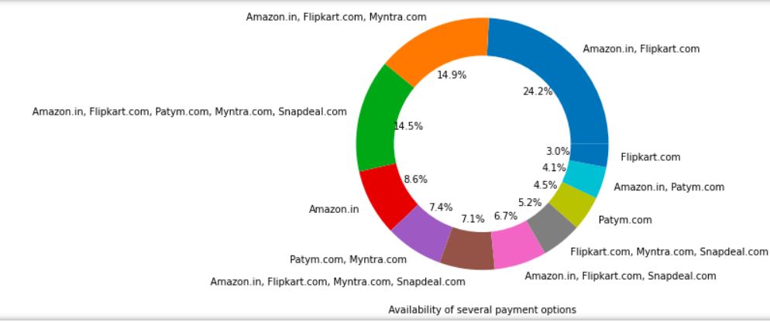

Slide 21
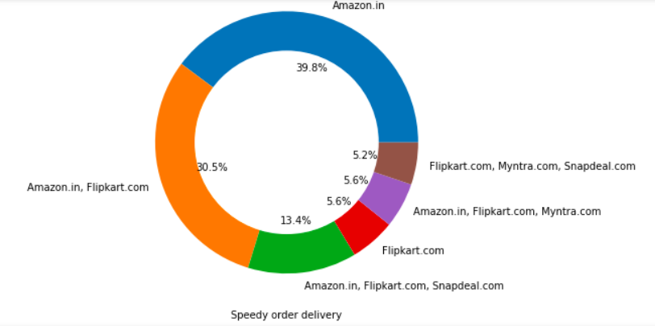
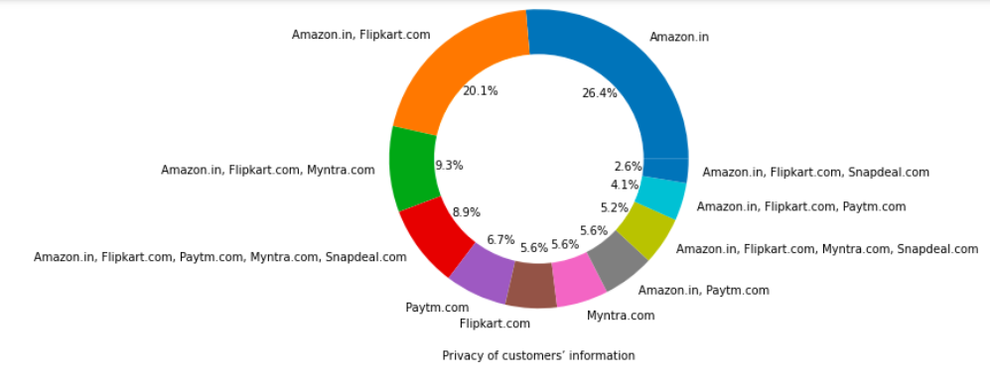
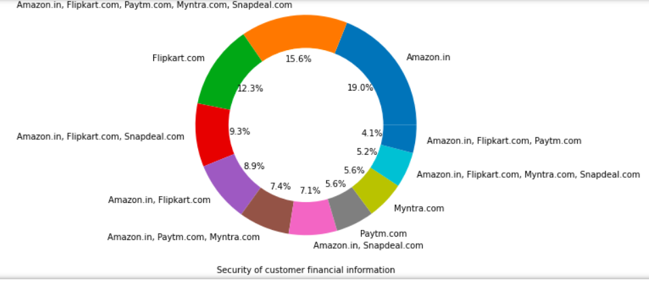
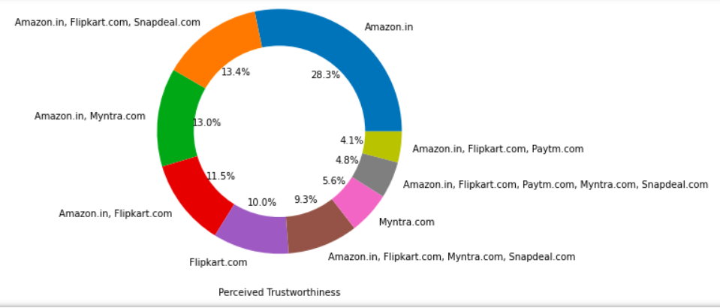

Slide 23
Conclusion:
Amazon, Flipkart have been had the highest votes for having all the positive points and have maintained a very good brand image followed by paytm and the myntra.

Slide 24
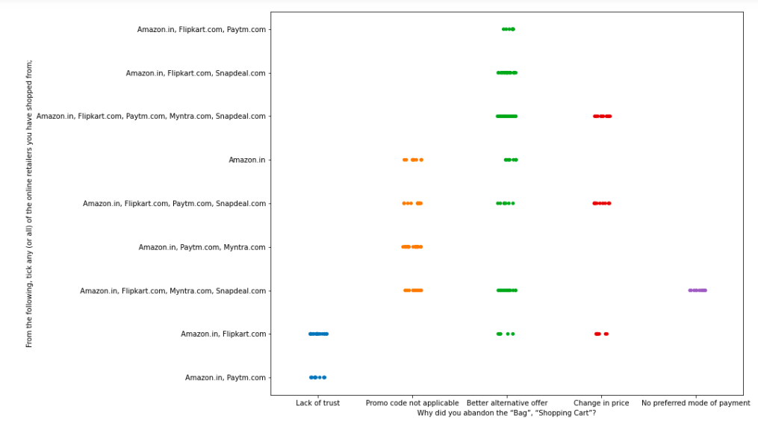
Conclusion: We can clearly see that most of the time people abandon the bag is beacuse they get a better alternative offer or promo code not applicable. There is also lack of trust seen in amazon, flipkart and paytm by some people.

Slide 25
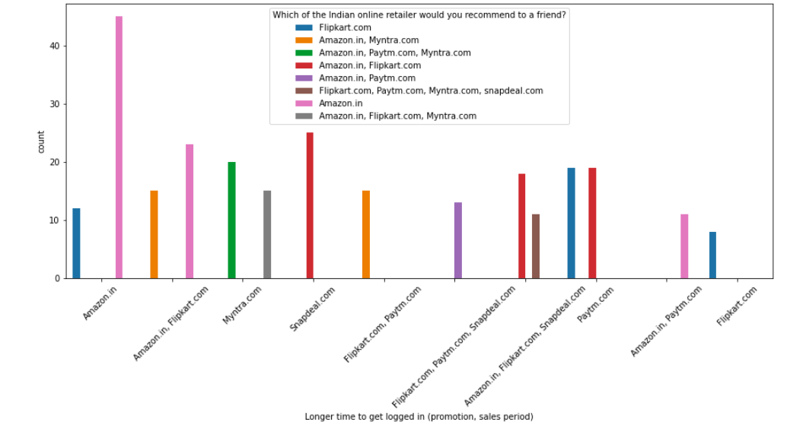

Slide 26
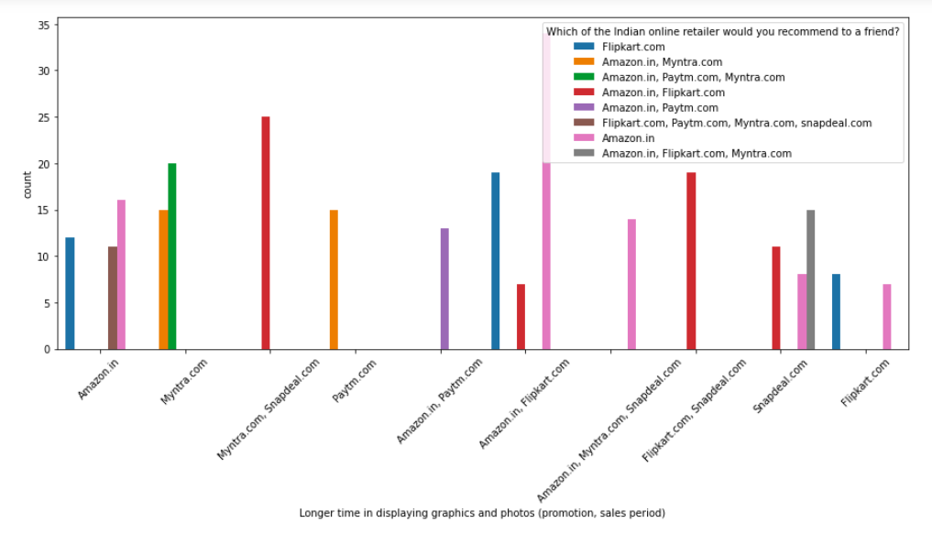

Slide 27
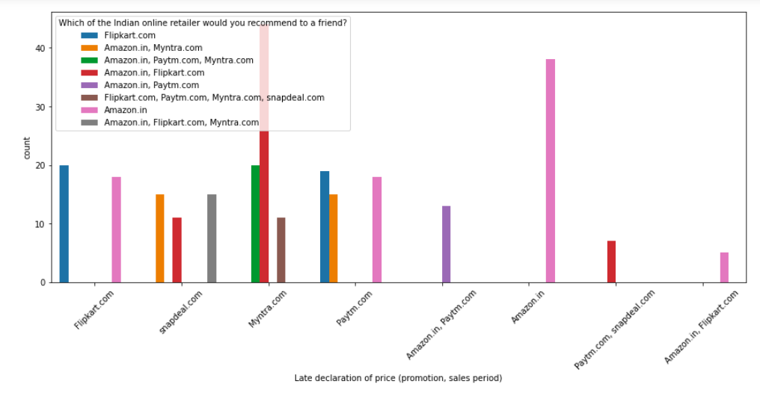

Slide 28
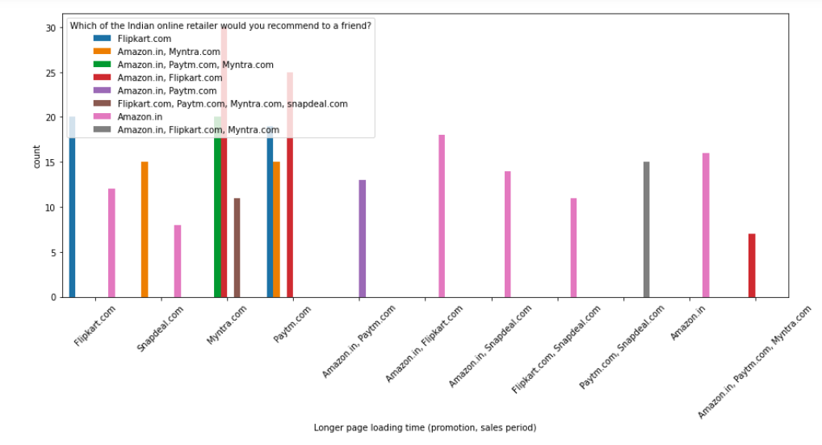

Slide 29
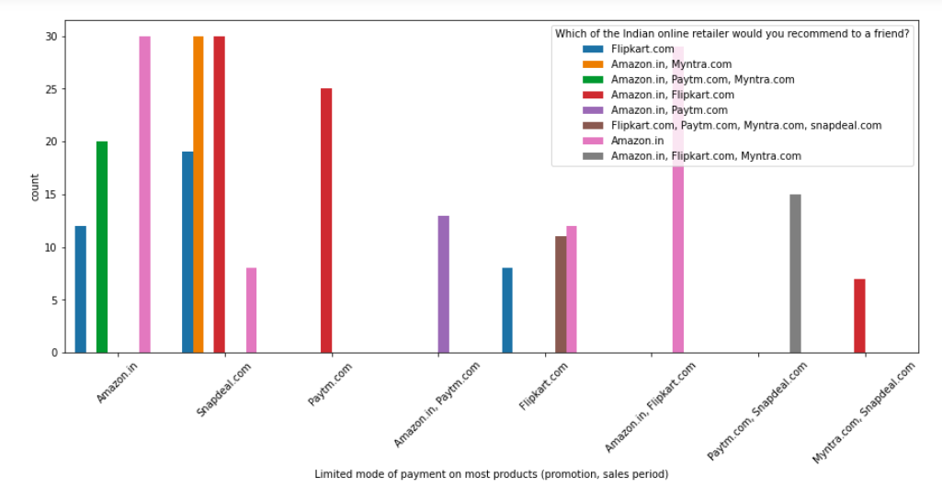

Slide 30
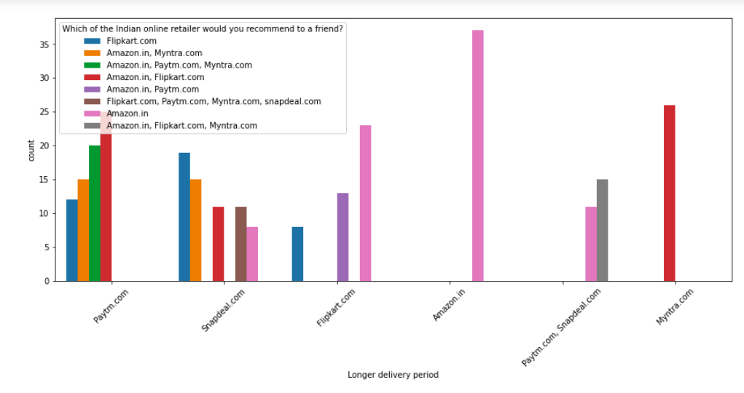

Slide 31
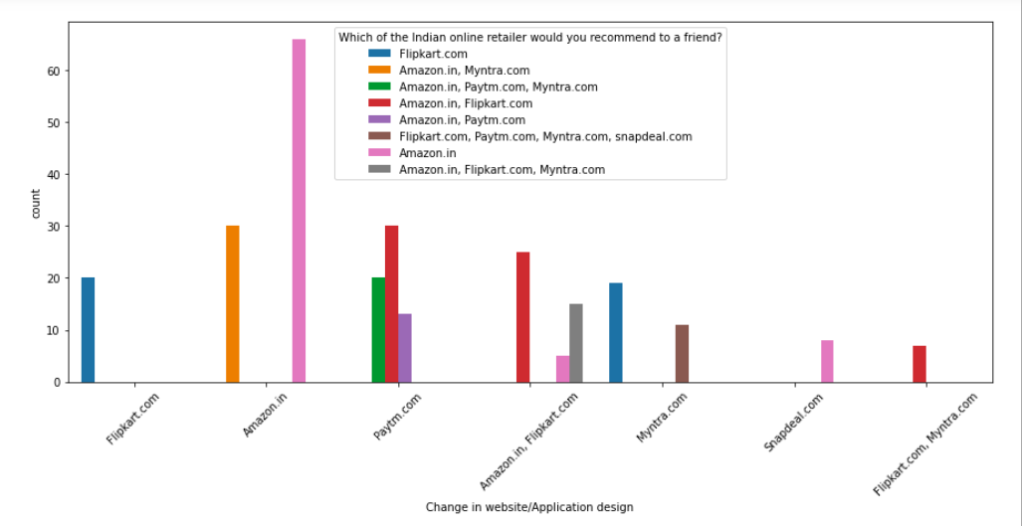

Slide 32
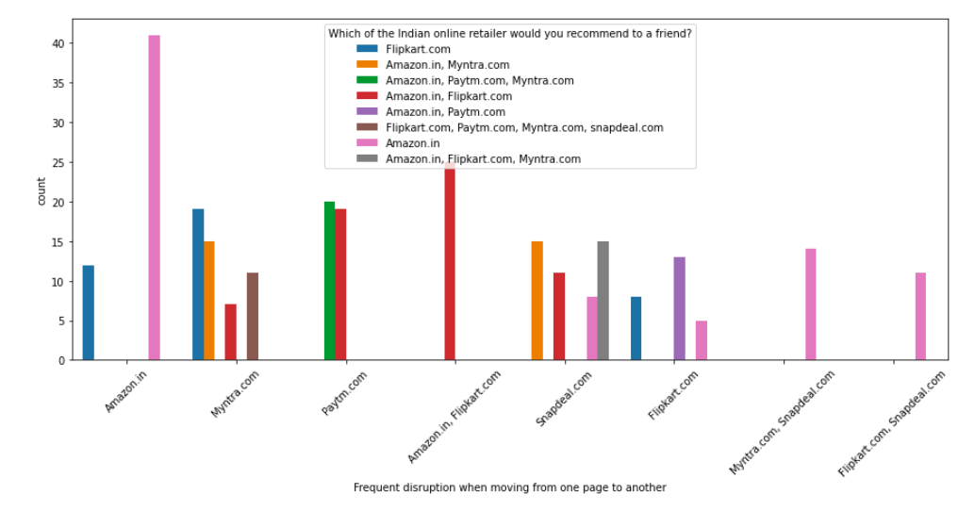

Slide 33
Conclusion:
Customers seem to be more loyal to amazon, flipkart and paytm as even though many of them have given negative remarks about them still they would recommend these platforms to their friend.

Slide 34
From all the studies we will be able to create a perfect model on which data can be trained and values can be predicted.

